Slide 1
Treasure Hunt
Let's start

Slide 2
01
Introduction

Slide 3
Treasure hunt app gameplay
There are 2 main modes for a user:
Game mode: a player searches and selects a game to play, where each game is composed by a set of steps that need to be solved.
Make mode: a user can create a game for other player by defining the steps of which it is made of.

Slide 4


Step types
Camera
The player has to guess an object by a question and make a photo of it
Position
The player has to guess a place to go by a question

Slide 5
Hints
The player has a maximum of 3 hints in each game to answer a question

Slide 6
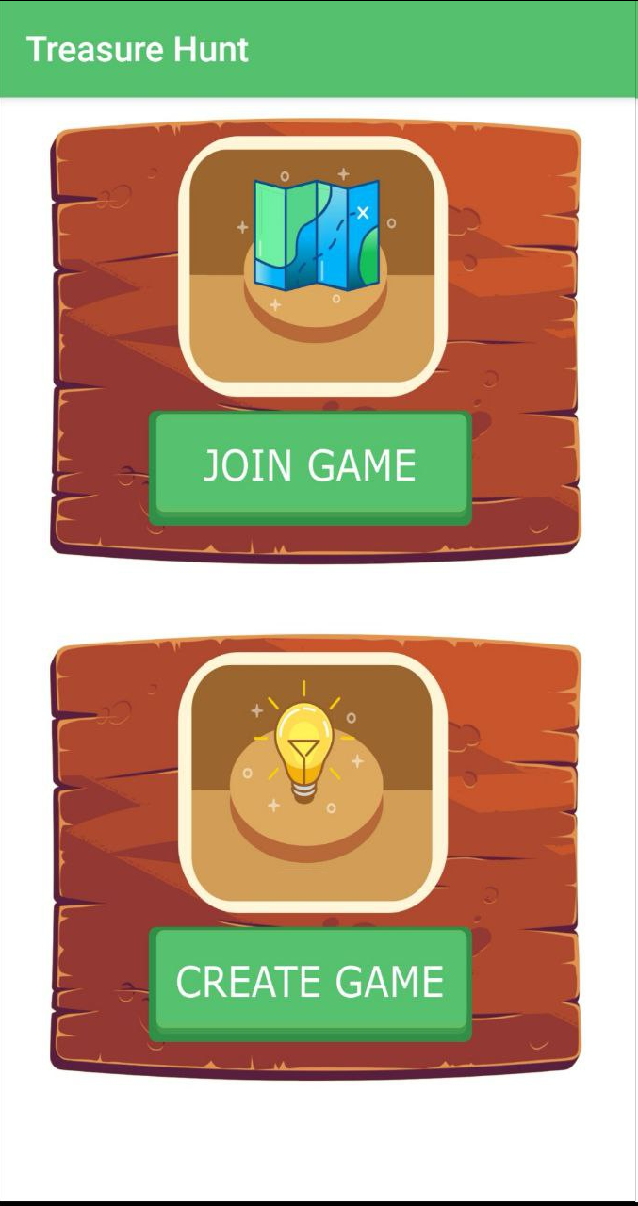
Initial
Activity

Slide 7
02
Game Frontend

Slide 8
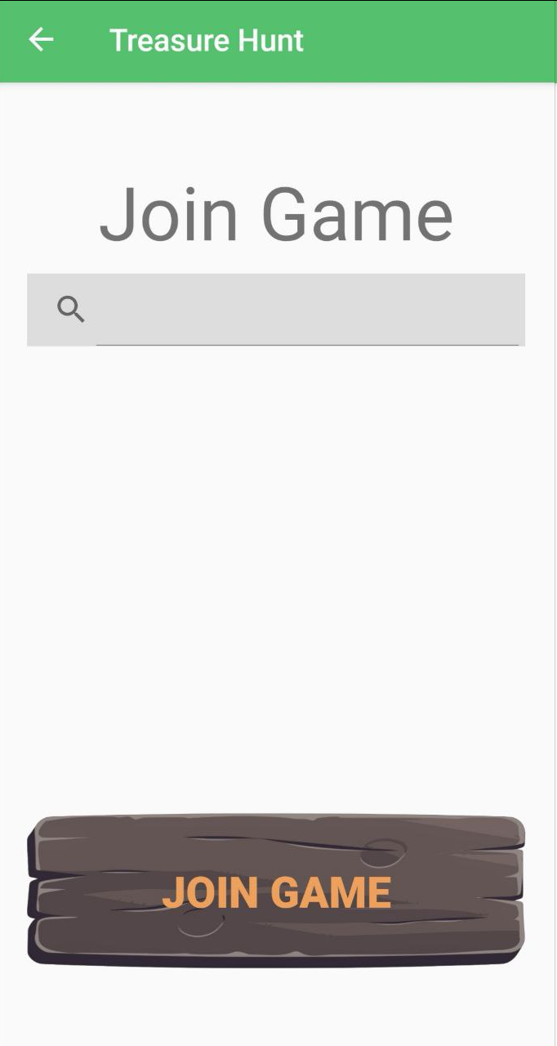
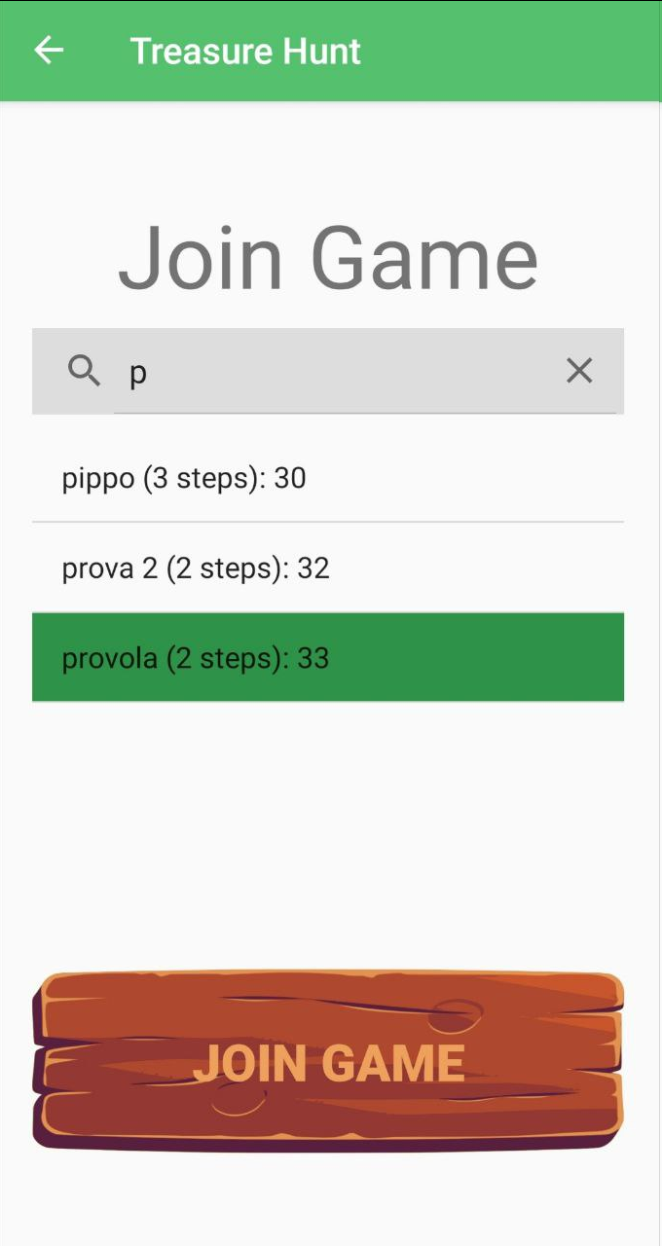
Search
Game
Activity

Slide 9
Search
Game
Activity

Slide 10
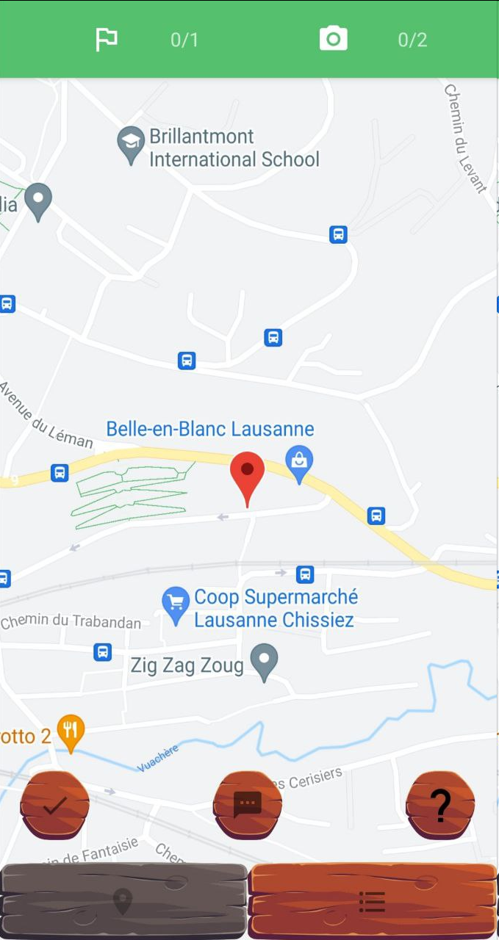
Game Activity
Position step counter
Image step counter
Steps question
Step hint
Check step
Steps list

Slide 11
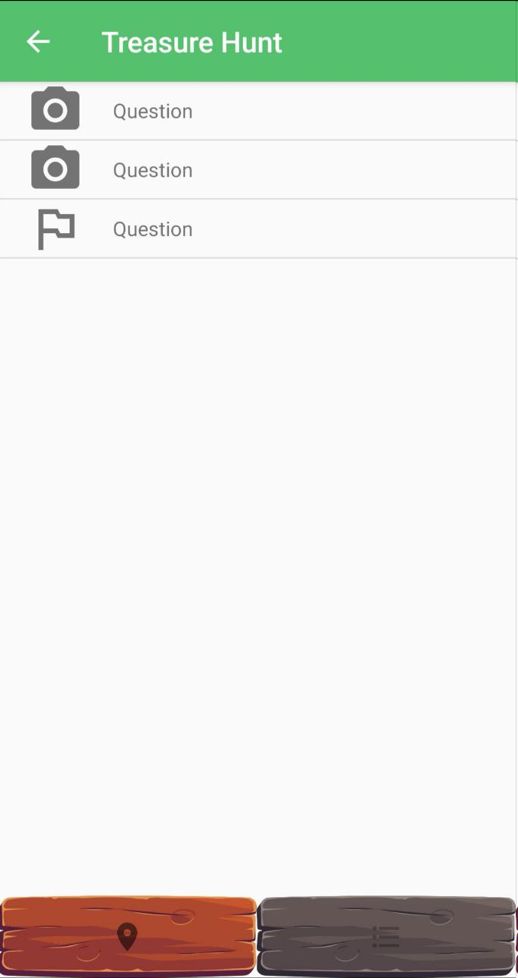
Steps list
Activity

Slide 12

Question Activity

Slide 13
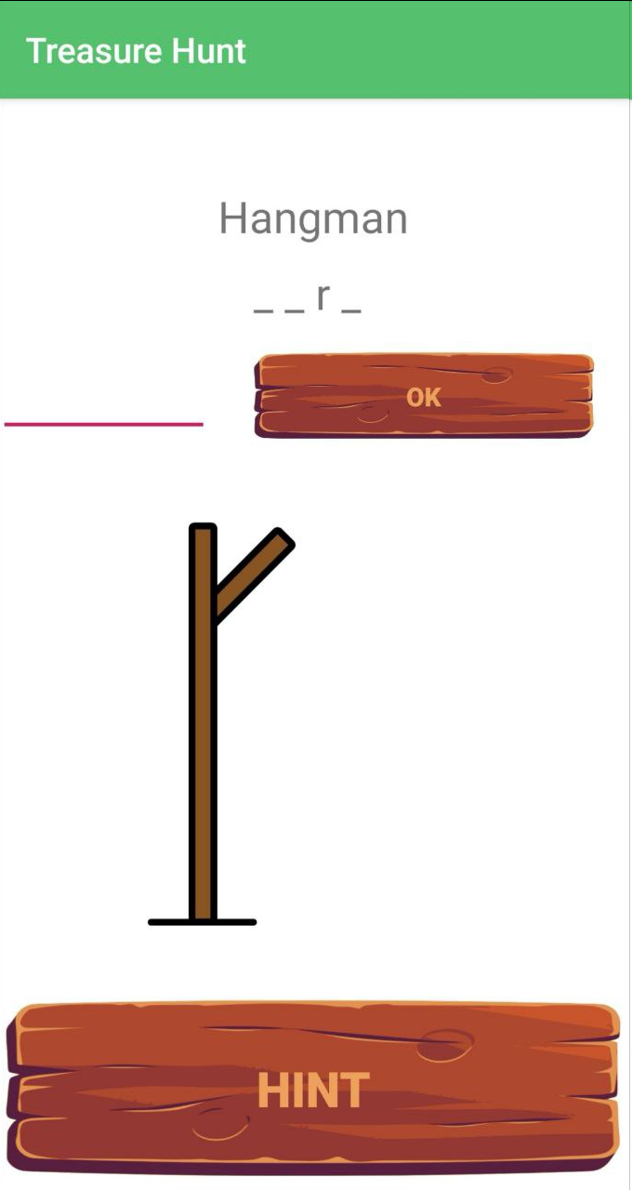
Camera
Hint Activity
Insert field
Letters found
Hint to add new letter

Slide 14
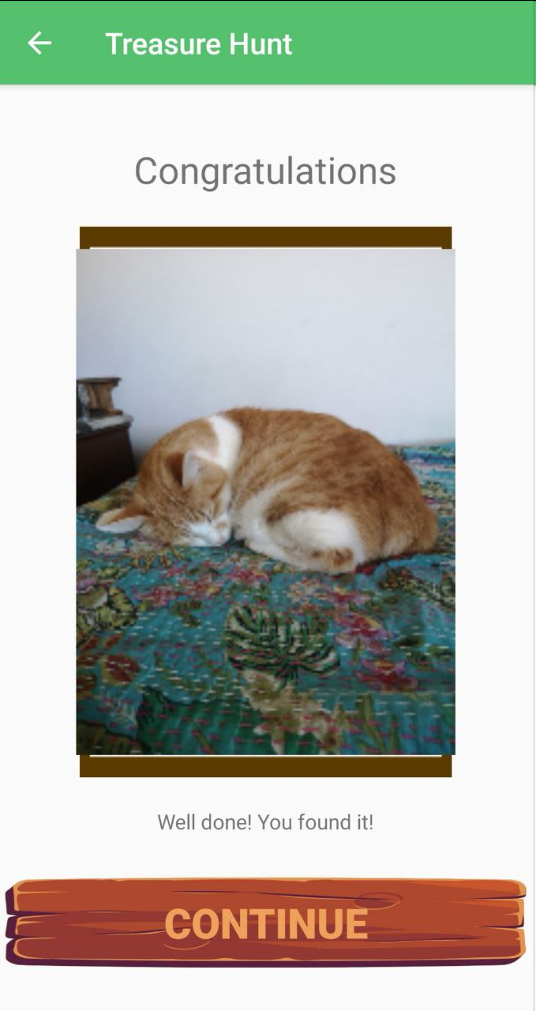
Camera check Activity

Slide 15
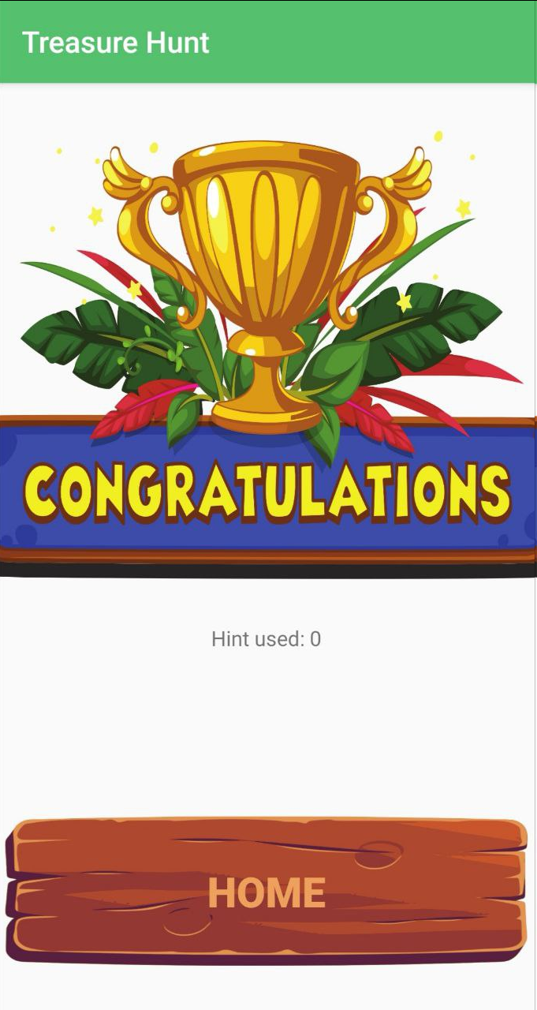
Success
Activity

Slide 16
03
Make Frontend

Slide 17
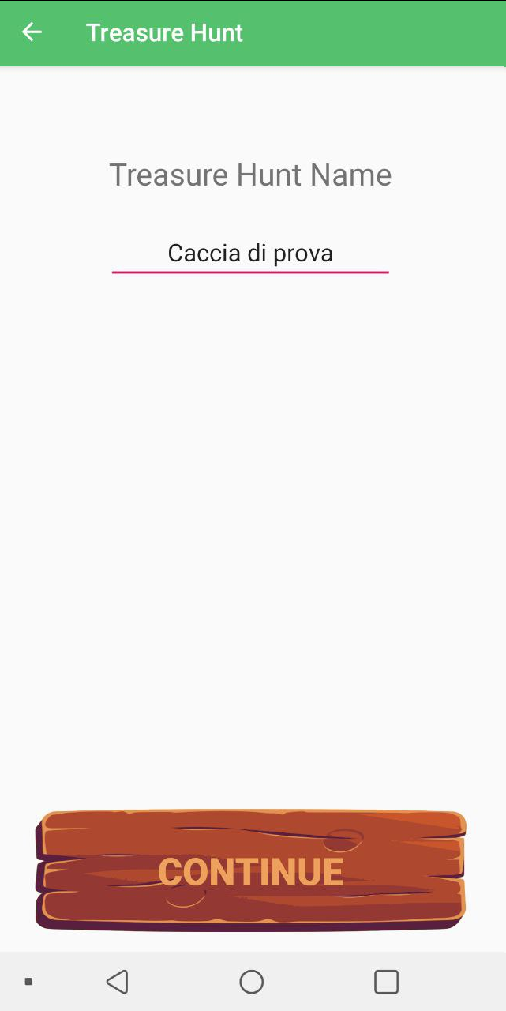
Game Name form Activity
Everyone can also create own educational game just clicking on Make button

Slide 18
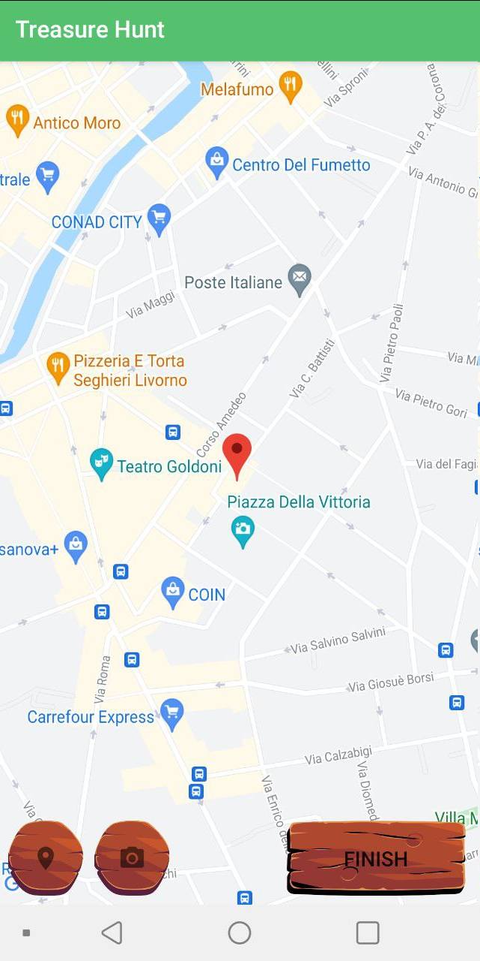
Maker Map Activity
Most important activity for the maker Three buttons to interact with:
Place for place steps
Camera for recognition steps
Finish to conclude

Slide 19
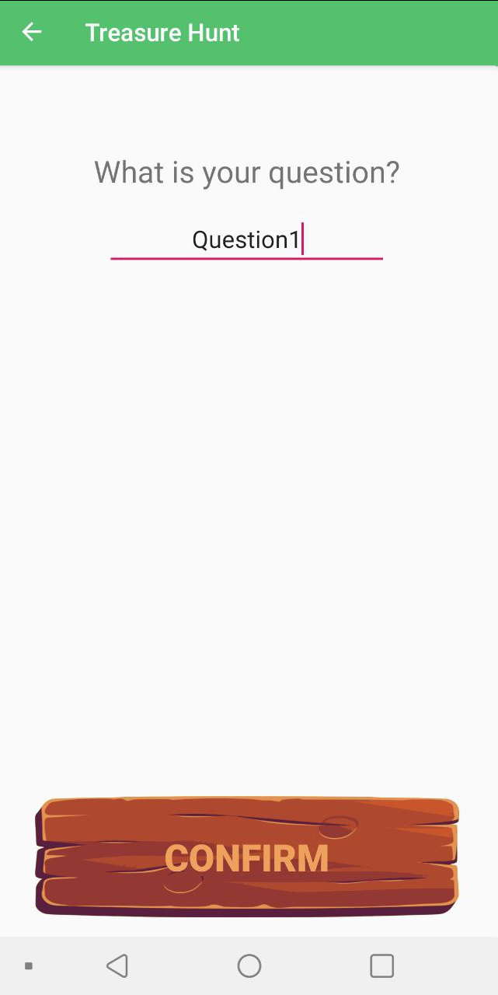
Place
Activity

Slide 20
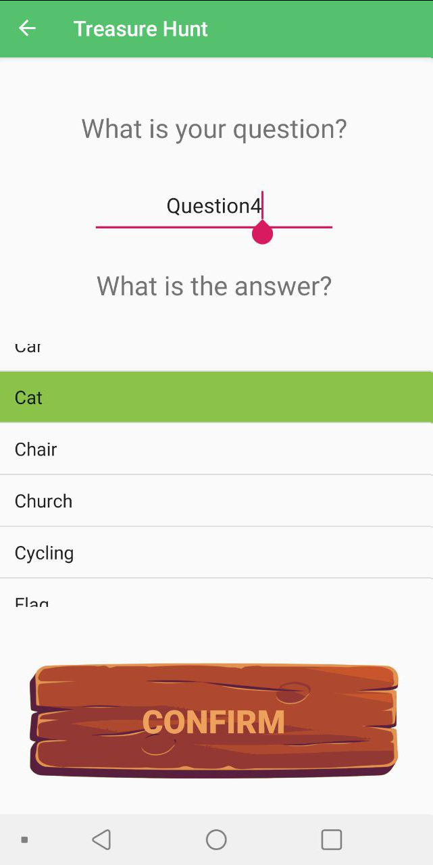
Camera Activity
ScrollView contains some label contained in ML Kit Constraints:
Not empty question
No selected options

Slide 21
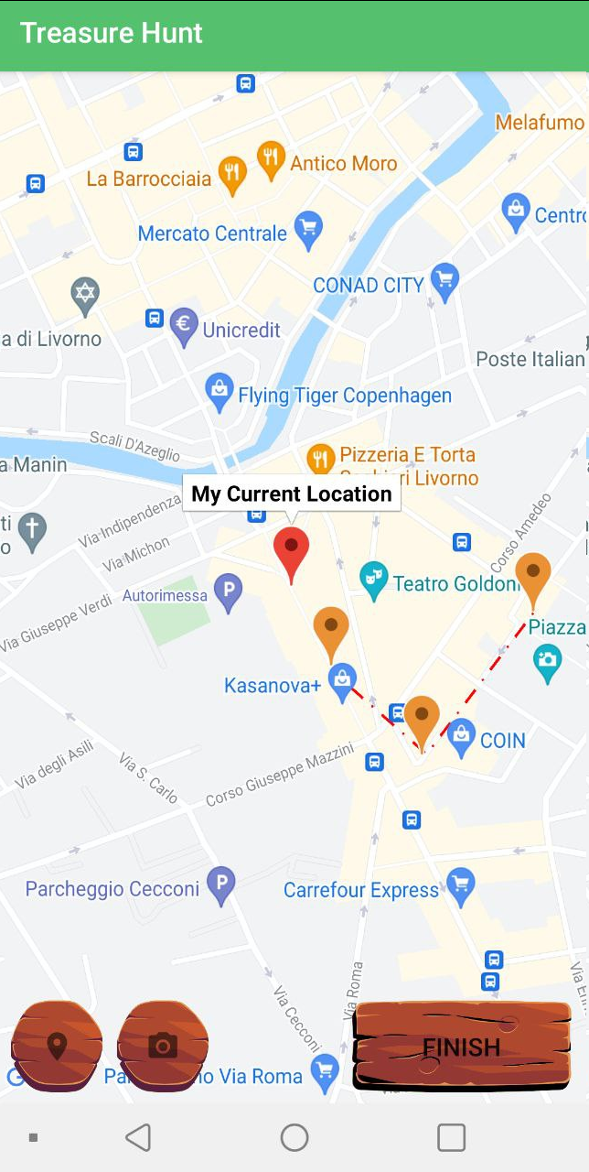
Maker Map Activity
Constraint: At least two steps

Slide 22
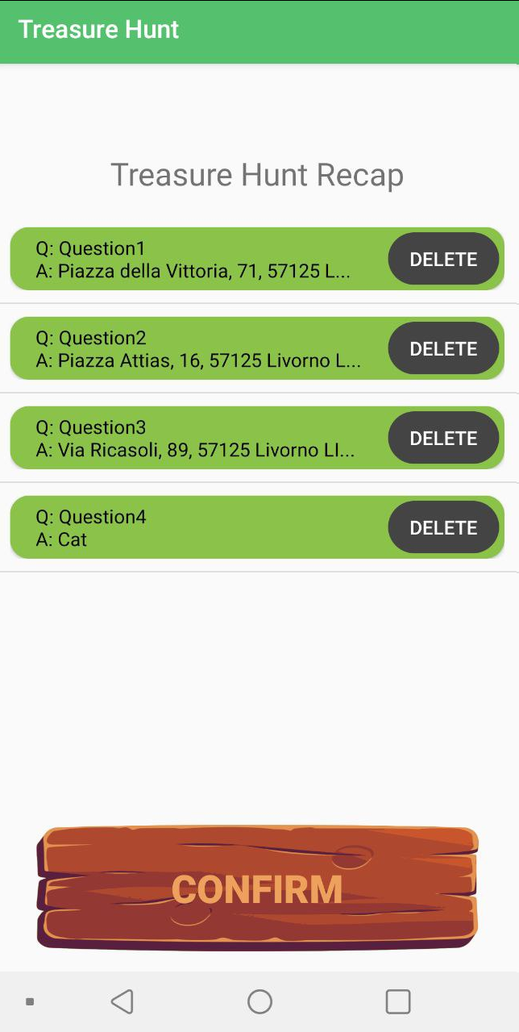
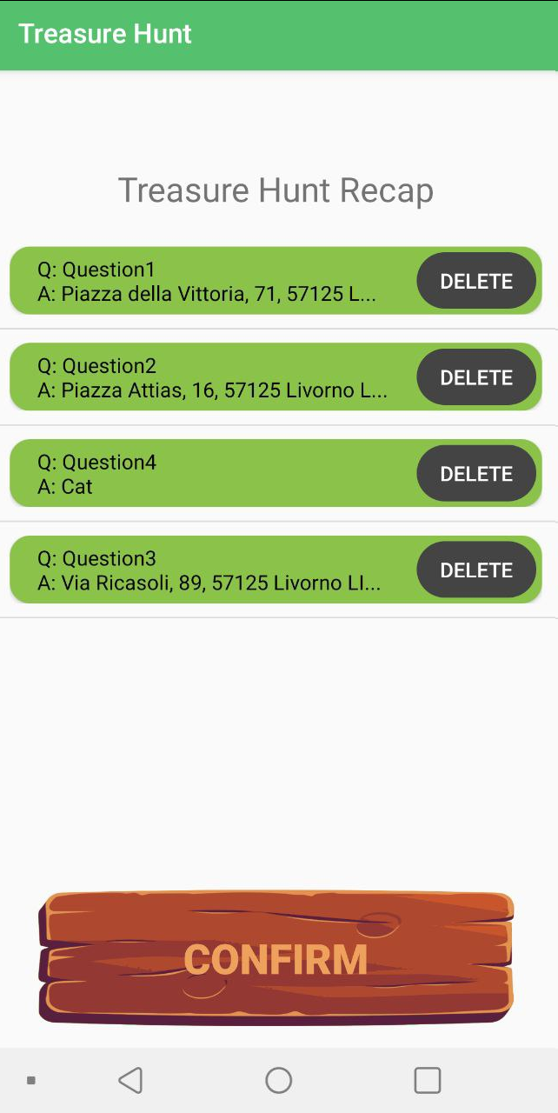
Recap Activity
Consistency handle
drag and drop
delete
back button
Clicking on finish: POST request and gameId response using Volley

Slide 23
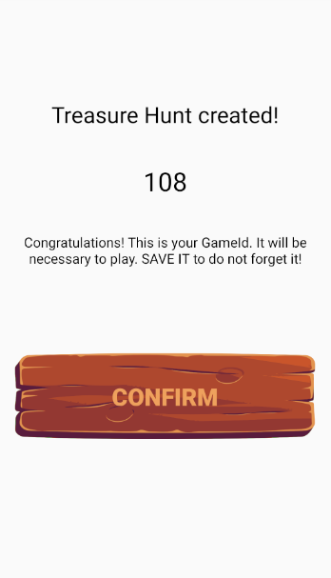
Success Creation Activity

Slide 24
Database
MySQL database contains a simple table
Each row of this table represents a step of a given Treasure Hunt
gameID | step | gameName | question | answer | stepType
109 | 1 | Test piazza | Question | lat/lgn: (37.4219... | 1
109 | 2 | Test piazza | Question | Car | 0
108 | 1 | Test | Question | Bird | 0
108 | 2 | Test | Question | School | 0

Slide 25
Backend
Maven project with the following dependencies:
Spring boot: allows to realize the backend application and define the REST calls using annotations.
Mysql-connect: allows connecting backend and database
Json-simple: allows creating Json objects
Hibernate: ORM service to handle data persistence in the MySql database using annotations and to maintain a relational database formed by Java classes. Allows definition of EntityManagers

Slide 26
REST API
GET /game?gameId=x: returns every step of the game with gameId x
POST /game : saves all the steps of a new game in the database. The response contains the GameId used to save it
DELETE /game/gameId=x : deletes all the record of the treasure hunt with gameid x. Used in debugging.
GET /games?initName=x : returns gameId, gameName and number of steps for every treasure hunt that starts with x
DELETE /step?gameId=x&step=y : deletes a record of a given game and deal with the step inconsistencies. Used in debug

Slide 27
04
Location-based functionalities
Google map API
integration

Slide 28
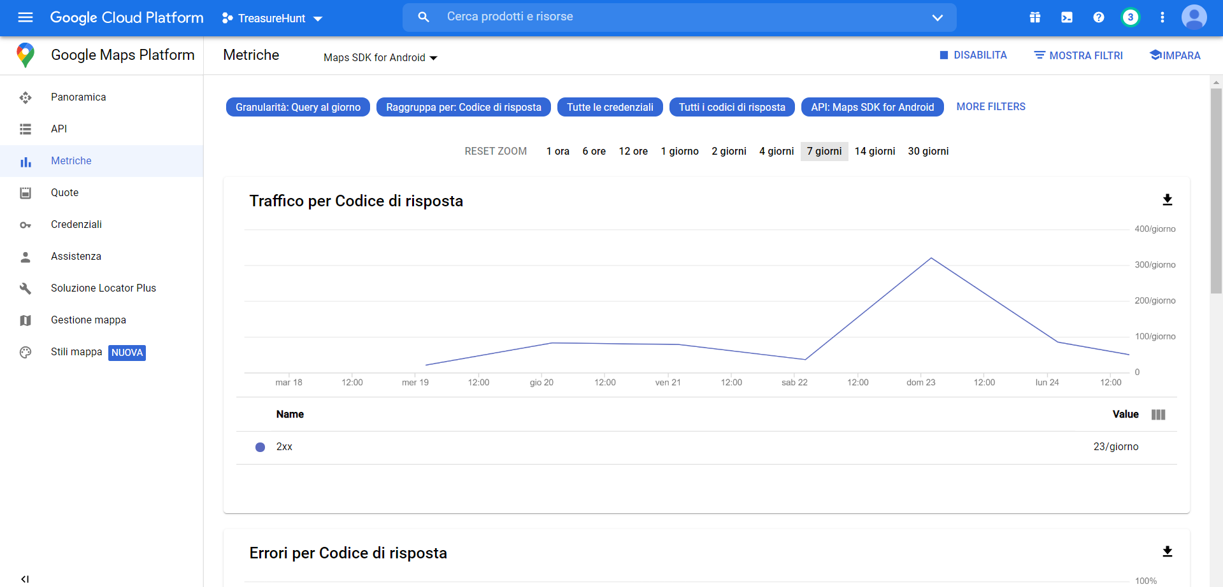
Map setup and init
How to start using Google API
API ENABLING
AND KEY ACTIVATION
ANALYTICS AROUND
TRAFFIC RATE

Slide 29
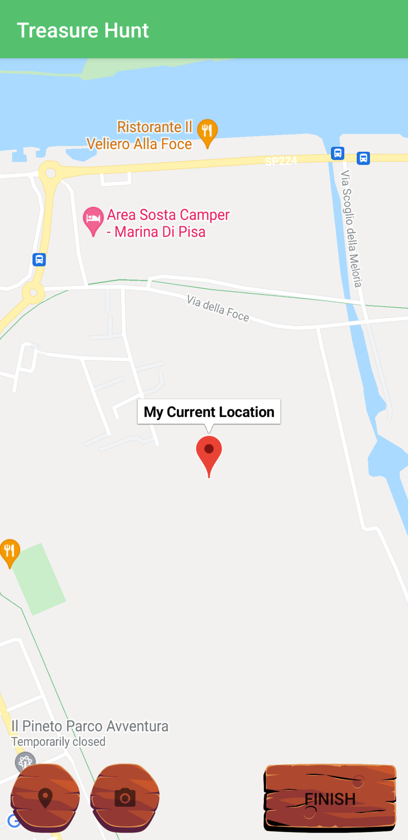
Map Activity
Initialization

Slide 30
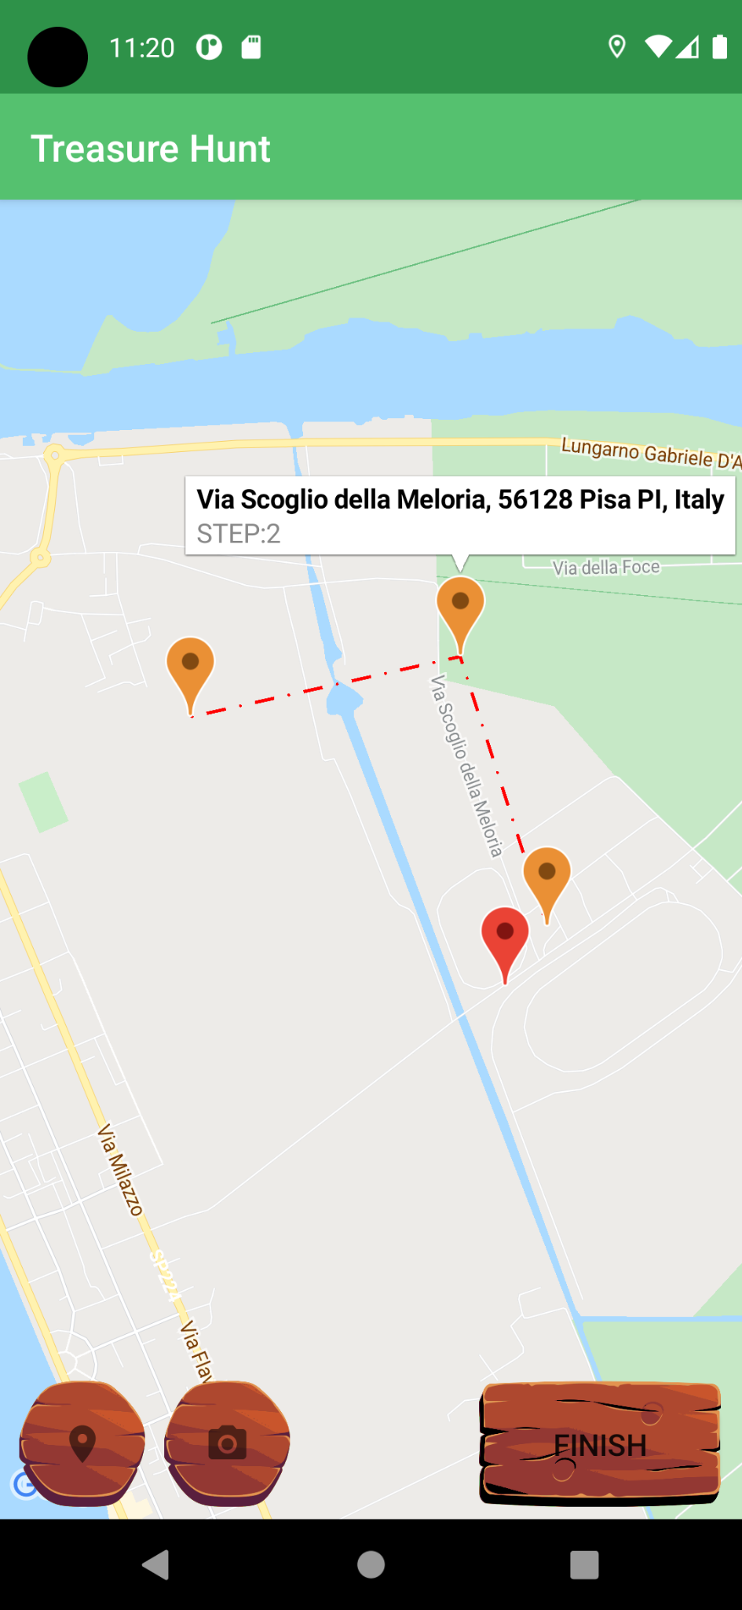
Graphic recap of game steps

Slide 31
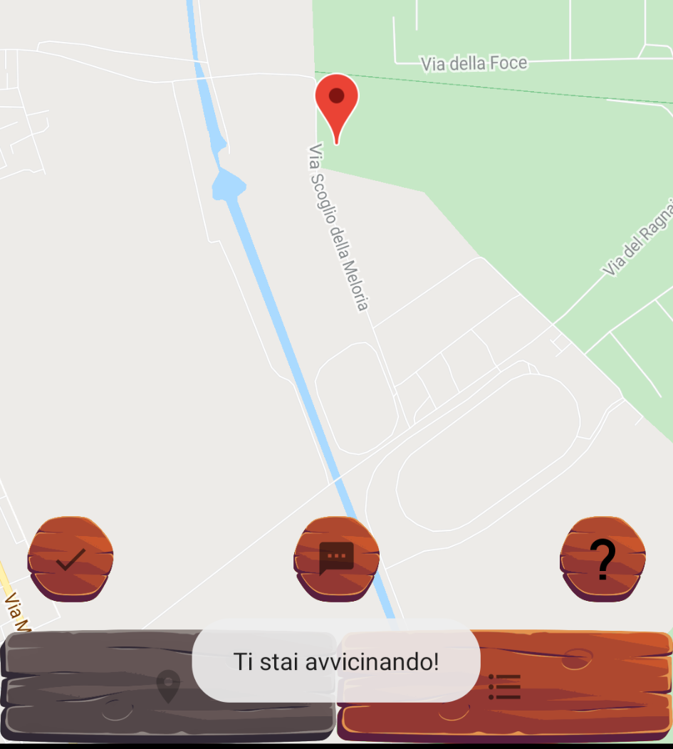
Location check
DIFFERENT LOCATION-BASED FEEDBACK ARE GIVEN:
Very close (< 100m)
On the right way (< 1 km)
On the wrong way

Slide 32
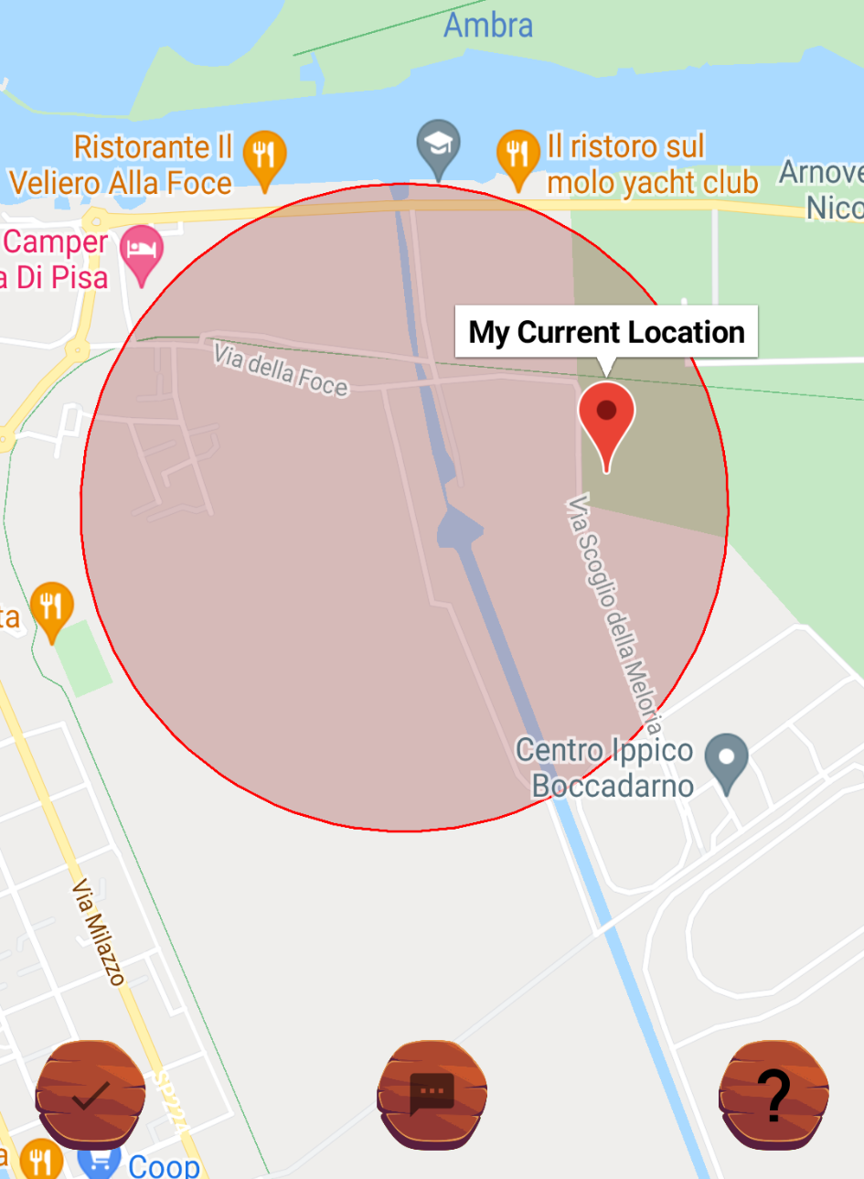
Location-based user support
USER SUPPORT FOR LOCATION
Whenever a user need support to find a location can use a hint and a red circle surrounding the target place is shown.
Circle radius was set to be 500 meters long.
ON CLICK:
Area of interest is displayed

Slide 33
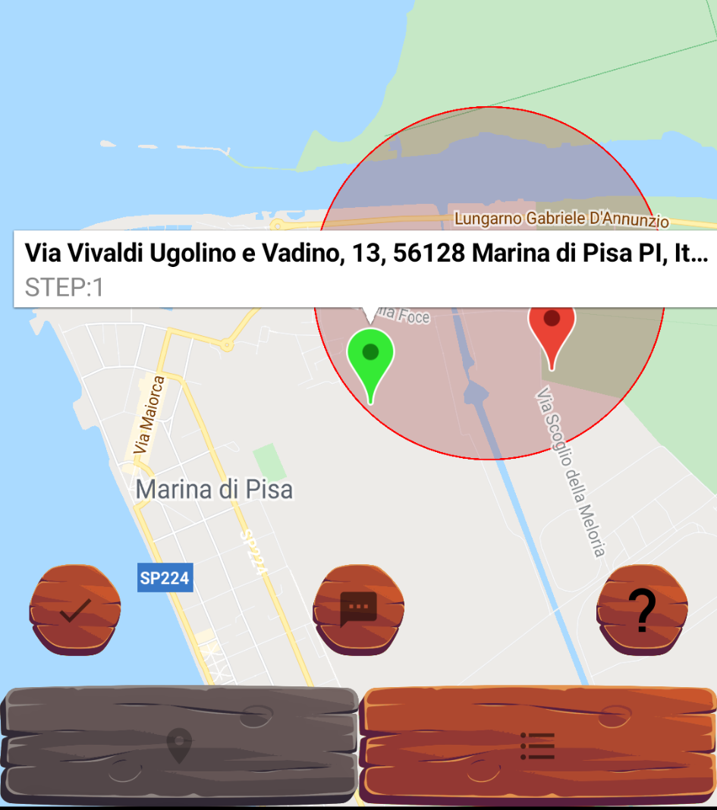
Step completion

Slide 34
05
Machine-Learning functionalities
Google ML SDK for Mobile integration

Slide 35

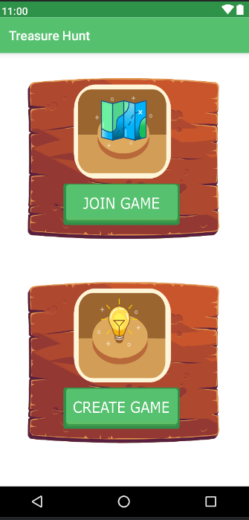
Material Design
Components: interactive building blocks for creating a user interface.
Experience: User flows, error handling.
Theming: Color, shape, typography.

Slide 36




ML KIT
Tensor Flow
Android iOS
Lite

Slide 37
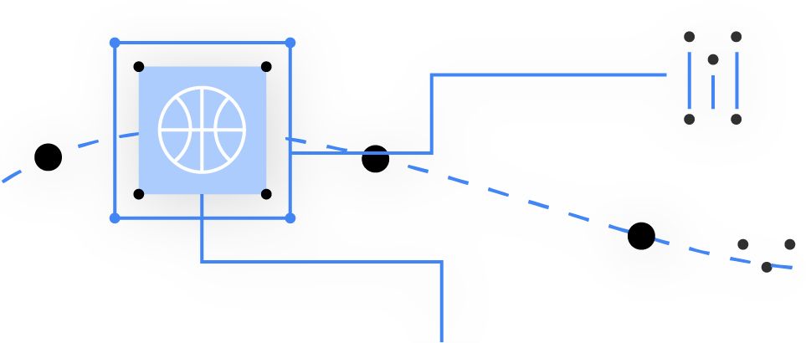


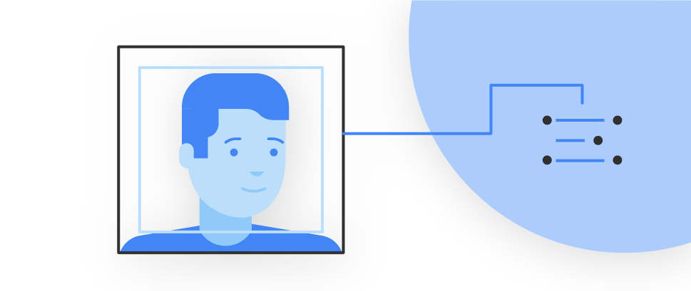






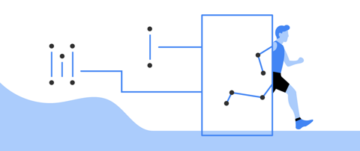
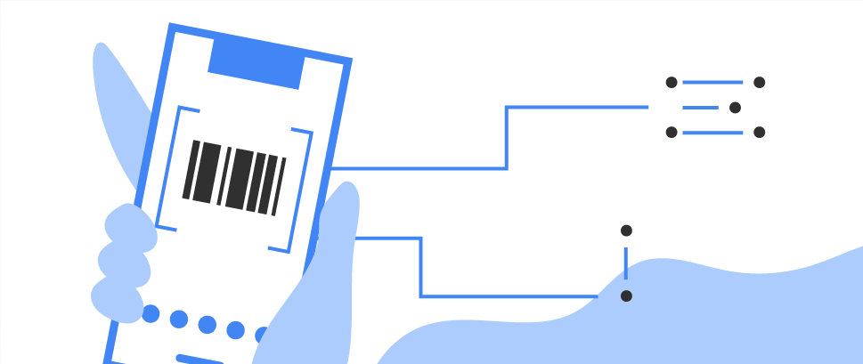
Vision
Neural Language
Custom

Slide 38


Machine Learning Kit
Vision APIs from google
Image labeling
Support more 400+ labels
Identify people, things, places, activities, etc
= boat

Slide 39
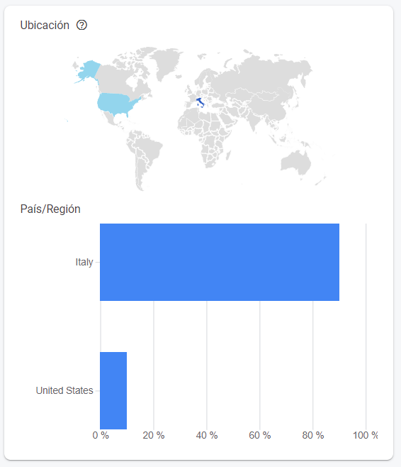
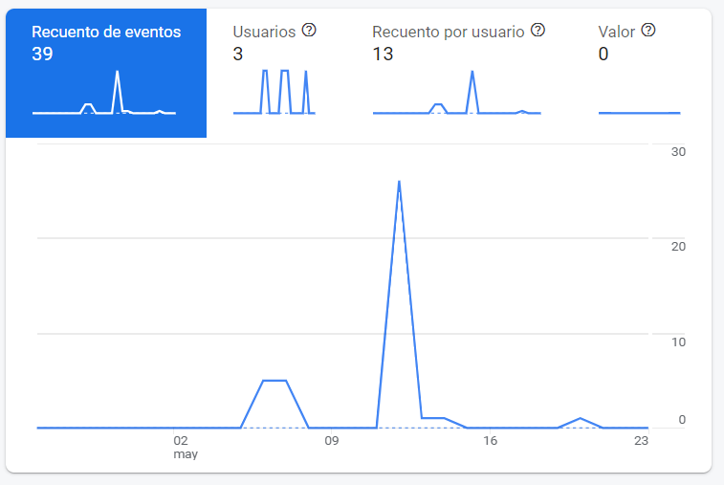
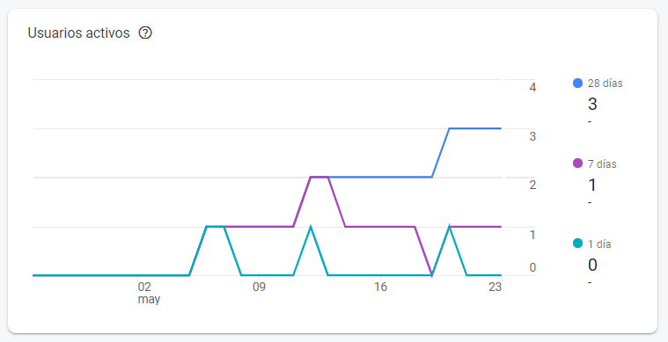
Google Analytics

Slide 40
Arrrrrrrr!!
You are going to love the game!!
Be the best pirate!!

